Slide 1
Digital Logic & Design Final Project
Ryan Armstrong
November 21 2022
CMPS4252

Slide 2
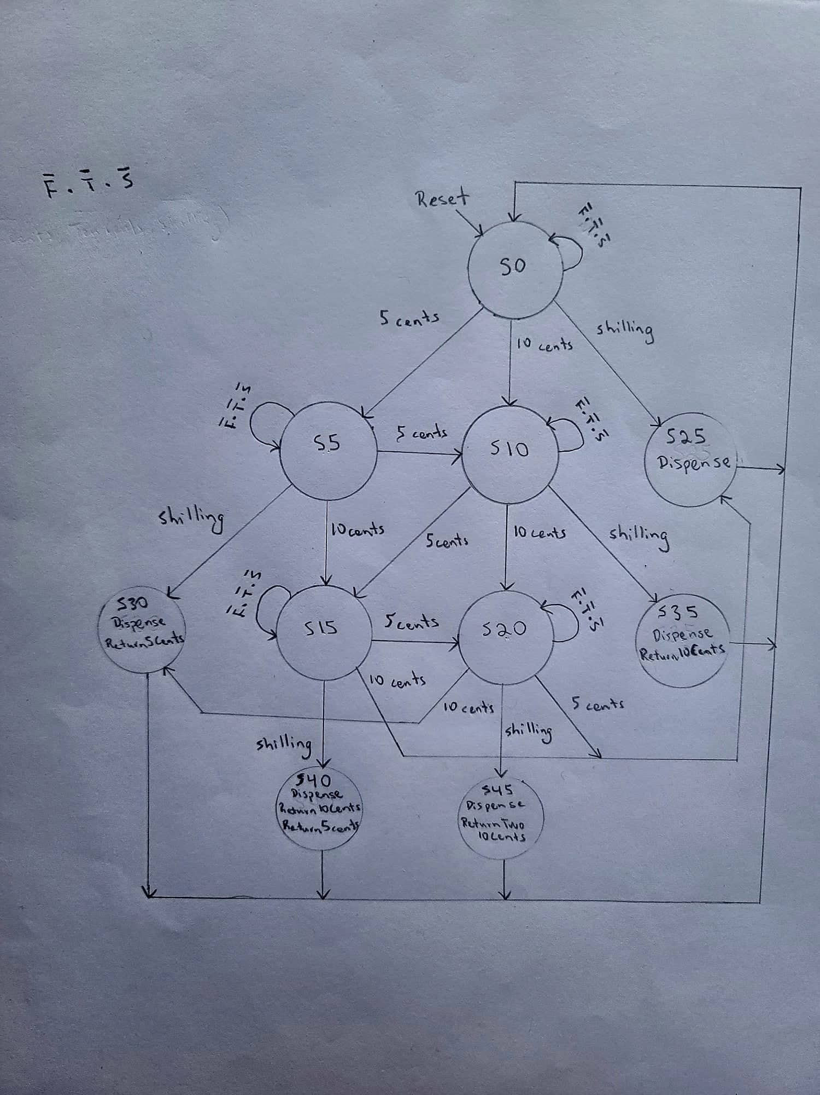
Modified FSM

Slide 3
State Encodings
S0 | 0000000001
S5 | 0000000010
S10 | 0000000100
S25 | 0000001000
S30 | 0000010000
S15 | 0000100000
S20 | 0001000000
S35 | 0010000000
S40 | 0100000000
S45 | 1000000000

Slide 4
State Transition Table
Current State |  |  |  |  |  |  |  |  |  |  | Inputs |  |  |  | Next State
S₉ | S₈ | S₇ | S₆ | S₅ | S₄ | S₃ | S₂ | S₁ | S₀ |  | F | T | S |  | S’₉ | S’₈ | S’₇ | S’₆ | S’₅ | S’₄ | S’₃ | S’₂ | S’₁ | S’₀
0 | 0 | 0 | 0 | 0 | 0 | 0 | 0 | 0 | 1 |  | 0 | 0 | 0 |  | 0 | 0 | 0 | 0 | 0 | 0 | 0 | 0 | 0 | 1
0 | 0 | 0 | 0 | 0 | 0 | 0 | 0 | 0 | 1 |  | 0 | 0 | 1 |  | 0 | 0 | 0 | 0 | 0 | 0 | 1 | 0 | 0 | 0
0 | 0 | 0 | 0 | 0 | 0 | 0 | 0 | 0 | 1 |  | 0 | 1 | 0 |  | 0 | 0 | 0 | 0 | 0 | 0 | 0 | 1 | 0 | 0
0 | 0 | 0 | 0 | 0 | 0 | 0 | 0 | 0 | 1 |  | 1 | 0 | 0 |  | 0 | 0 | 0 | 0 | 0 | 0 | 0 | 0 | 1 | 0
0 | 0 | 0 | 0 | 0 | 0 | 0 | 0 | 1 | 0 |  | 0 | 0 | 0 |  | 0 | 0 | 0 | 0 | 0 | 0 | 0 | 0 | 1 | 0
0 | 0 | 0 | 0 | 0 | 0 | 0 | 0 | 1 | 0 |  | 0 | 0 | 1 |  | 0 | 0 | 0 | 0 | 0 | 1 | 0 | 0 | 0 | 0
0 | 0 | 0 | 0 | 0 | 0 | 0 | 0 | 1 | 0 |  | 0 | 1 | 0 |  | 0 | 0 | 0 | 0 | 1 | 0 | 0 | 0 | 0 | 0
0 | 0 | 0 | 0 | 0 | 0 | 0 | 0 | 1 | 0 |  | 1 | 0 | 0 |  | 0 | 0 | 0 | 0 | 0 | 0 | 0 | 1 | 0 | 0
0 | 0 | 0 | 0 | 0 | 0 | 0 | 1 | 0 | 0 |  | 0 | 0 | 0 |  | 0 | 0 | 0 | 0 | 0 | 0 | 0 | 1 | 0 | 0
0 | 0 | 0 | 0 | 0 | 0 | 0 | 1 | 0 | 0 |  | 0 | 0 | 1 |  | 0 | 0 | 1 | 0 | 0 | 0 | 0 | 0 | 0 | 0
0 | 0 | 0 | 0 | 0 | 0 | 0 | 1 | 0 | 0 |  | 0 | 1 | 0 |  | 0 | 0 | 0 | 1 | 0 | 0 | 0 | 0 | 0 | 0
0 | 0 | 0 | 0 | 0 | 0 | 0 | 1 | 0 | 0 |  | 1 | 0 | 0 |  | 0 | 0 | 0 | 0 | 1 | 0 | 0 | 0 | 0 | 0
0 | 0 | 0 | 0 | 0 | 0 | 1 | 0 | 0 | 0 |  | X | X | X |  | 0 | 0 | 0 | 0 | 0 | 0 | 0 | 0 | 0 | 1
0 | 0 | 0 | 0 | 0 | 1 | 0 | 0 | 0 | 0 |  | X | X | X |  | 0 | 0 | 0 | 0 | 0 | 0 | 0 | 0 | 0 | 1

Slide 5
Current State |  |  |  |  |  |  |  |  |  |  | Inputs |  |  |  | Next State
S₉ | S₈ | S₇ | S₆ | S₅ | S₄ | S₃ | S₂ | S₁ | S₀ |  | F | T | S |  | S’₉ | S’₈ | S’₇ | S’₆ | S’₅ | S’₄ | S’₃ | S’₂ | S’₁ | S’₀
0 | 0 | 0 | 0 | 1 | 0 | 0 | 0 | 0 | 0 |  | 0 | 0 | 0 |  | 0 | 0 | 0 | 0 | 1 | 0 | 0 | 0 | 0 | 0
0 | 0 | 0 | 0 | 1 | 0 | 0 | 0 | 0 | 0 |  | 0 | 0 | 1 |  | 0 | 1 | 0 | 0 | 0 | 0 | 0 | 0 | 0 | 0
0 | 0 | 0 | 0 | 1 | 0 | 0 | 0 | 0 | 0 |  | 0 | 1 | 0 |  | 0 | 0 | 0 | 0 | 0 | 0 | 1 | 0 | 0 | 0
0 | 0 | 0 | 0 | 1 | 0 | 0 | 0 | 0 | 0 |  | 1 | 0 | 0 |  | 0 | 0 | 0 | 1 | 0 | 0 | 0 | 0 | 0 | 0
0 | 0 | 0 | 1 | 0 | 0 | 0 | 0 | 0 | 0 |  | 0 | 0 | 0 |  | 0 | 0 | 0 | 1 | 0 | 0 | 0 | 0 | 0 | 0
0 | 0 | 0 | 1 | 0 | 0 | 0 | 0 | 0 | 0 |  | 0 | 0 | 1 |  | 1 | 0 | 0 | 0 | 0 | 0 | 0 | 0 | 0 | 0
0 | 0 | 0 | 1 | 0 | 0 | 0 | 0 | 0 | 0 |  | 0 | 1 | 0 |  | 0 | 0 | 0 | 0 | 0 | 1 | 0 | 0 | 0 | 0
0 | 0 | 0 | 1 | 0 | 0 | 0 | 0 | 0 | 0 |  | 1 | 0 | 0 |  | 0 | 0 | 0 | 0 | 0 | 0 | 1 | 0 | 0 | 0
0 | 0 | 1 | 0 | 0 | 0 | 0 | 0 | 0 | 0 |  | X | X | X |  | 0 | 0 | 0 | 0 | 0 | 0 | 0 | 0 | 0 | 1
0 | 1 | 0 | 0 | 0 | 0 | 0 | 0 | 0 | 0 |  | X | X | X |  | 0 | 0 | 0 | 0 | 0 | 0 | 0 | 0 | 0 | 1
1 | 0 | 0 | 0 | 0 | 0 | 0 | 0 | 0 | 0 |  | X | X | X |  | 0 | 0 | 0 | 0 | 0 | 0 | 0 | 0 | 0 | 1

Slide 6
Next State Equation
S’₉ = S₆ S
S’₈ = S₅ S
S’₇ = S₂ S
S’₆ = S₂ T + S₅ F + S₆ F’T’S’

Slide 7
S’₅ = S₁ T + S₂ F + S₅ F’T’S’
S’₄ = S₁ S + S₆ T
S’₃ = S₀ S + S₅ T + S₆ F
S’₂ = S₀ T + S₁ F + S₂ F’T’S’
S’₁ = S₀ F + S₁ F’T’S’
S’₀ = S₀ F’T’S’ + S₃ + S₄ + S₇ + S₈ + S₉

Slide 8
Output/Encoding
Output | Encoding
Dispense | 00
Return5Cents | 01
Return10Cents | 10
ReturnTwo10Cents | 11

Slide 9
Output Table
Current State |  |  |  |  |  |  |  |  |  |  | Outputs
S₉ | S₈ | S₇ | S₆ | S₅ | S₄ | S₃ | S₂ | S₁ | S₀ |  | C₀ | C₁ | C₂ | C₃ | C₄ | C₅
0 | 0 | 0 | 0 | 0 | 0 | 1 | 0 | 0 | 0 |  | 0 | 0
0 | 0 | 0 | 0 | 0 | 1 | 0 | 0 | 0 | 0 |  | 0 | 0 | 0 | 1
0 | 0 | 1 | 0 | 0 | 0 | 0 | 0 | 0 | 0 |  | 0 | 0 | 1 | 0
0 | 1 | 0 | 0 | 0 | 0 | 0 | 0 | 0 | 0 |  | 0 | 0 | 1 | 0 | 0 | 1
1 | 0 | 0 | 0 | 0 | 0 | 0 | 0 | 0 | 0 |  | 0 | 0 | 1 | 1

Slide 10
Output Equation
Dispense = S₃ + S₄ + S₇ + S₈ + S₉
Return5Cents = S₄ + S₈
Return10Cents = S₇ + S₈
ReturnTwo10Cents = S₉

Slide 11
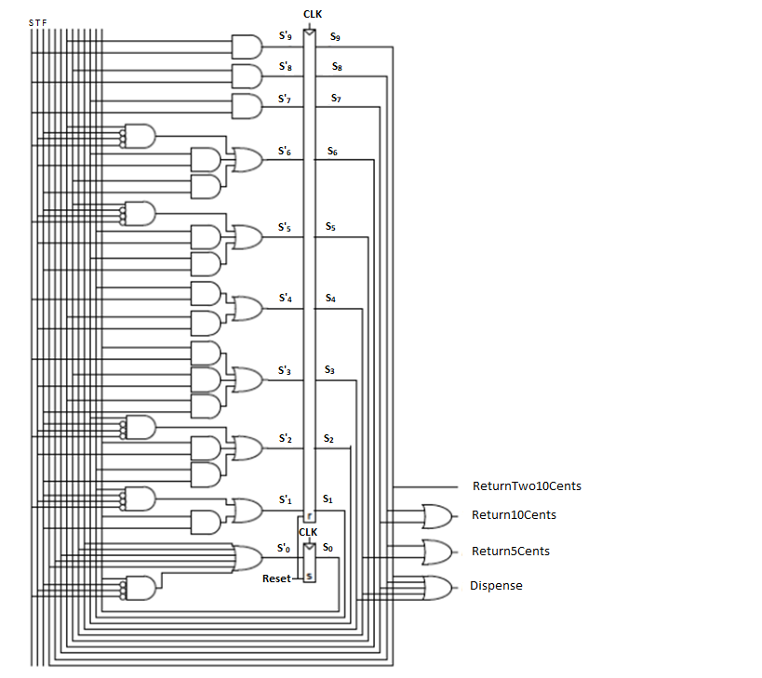
Circuit

